Slide 1
Foundation for Computer Science
Software School of Technology, Dalian University of Technology
2021.11

Slide 2
1 Recurrent Problems（递归问题）
1.1 The Tower of Hanoi（汉诺塔）
1.2 Lines in the Plane（平面上的直线）
1.3 The Josephus Problem （约瑟夫问题）
Common characteristics：
（1）Investigated repeatedly by mathematicians
（2）Use the idea of recurrence
（3）Each solution depends on solutions to smaller instances of the same problem

Slide 3
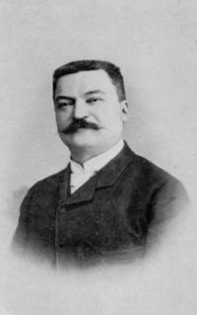
1.1 The Tower of Hanoi
The Tower of Hanoi puzzle was invented by the French
mathematician Edouard Lucas in 1883.
Rules:
One time, one disk;
No larger disks on smaller ones(Anytime).

Slide 4
1.1 The Tower of Hanoi
Q1:What’s the best we can do?
Q2:How many moves are necessary and sufficient?
The Tower of Hanoi → 8 disks （汉诺塔、河内塔）
The Tower of Brahma → 64 disks （梵天塔、婆罗贺摩塔）
Consider what happens if there are n disks.

Slide 5
1.1 The Tower of Hanoi
1 disk -> 1 step Very easy
2 disks -> 3 steps Very easy
3 disks -> 7 steps Easy
4 disks -> Can you show the answer immediately?
T_{n} is the minimum number of moves for n disks
Obviously, T₁ = 1, T₂ = 3, T₃ = 7…
Considering the smallest case: T₀ = 0 （0 disks）

Slide 6
1.1 The Tower of Hanoi
The winning idea for 3 disks:
Transfer the top two disks to the middle peg,
Then move the third,
Then bring the other two onto it.
The winning idea for n disks:
Transfer the n-1 smallest to a different peg (T_{n-1} moves),
Then move the largest (1 move) ,
Then transfer the n-1 smallest back onto the largest (Another T_{n-1} moves).

Slide 7

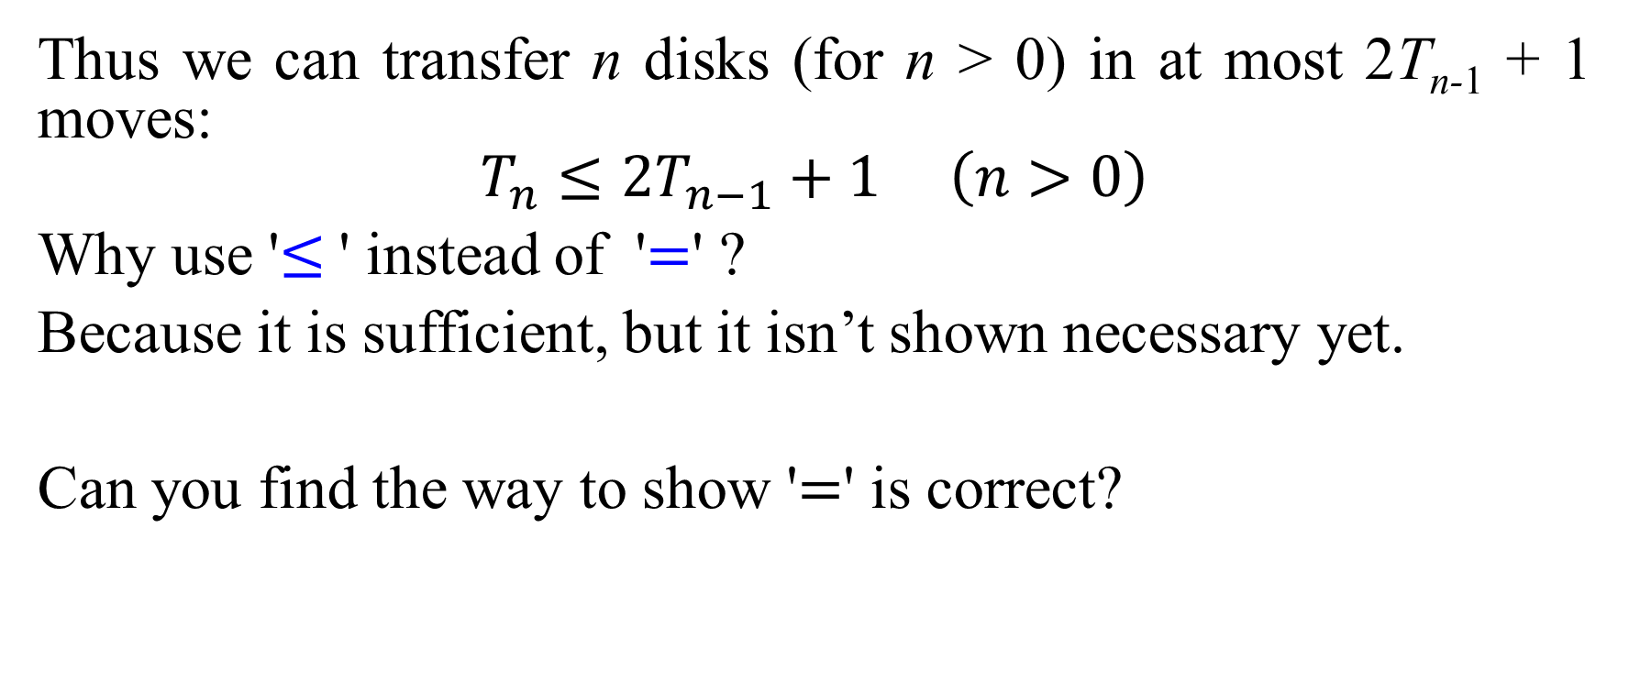
1.1 The Tower of Hanoi
Thus we can transfer n disks (for n > 0) in at most 2T_{n-1} + 1 moves:
$$T_{n}≤2T_{n−1}+1 \left(n>0\right)$$
Why use '$≤$' instead of '$=$' ?
Because it is sufficient, but it isn’t shown necessary yet.
Can you find the way to show '$=$' is correct?

Slide 8
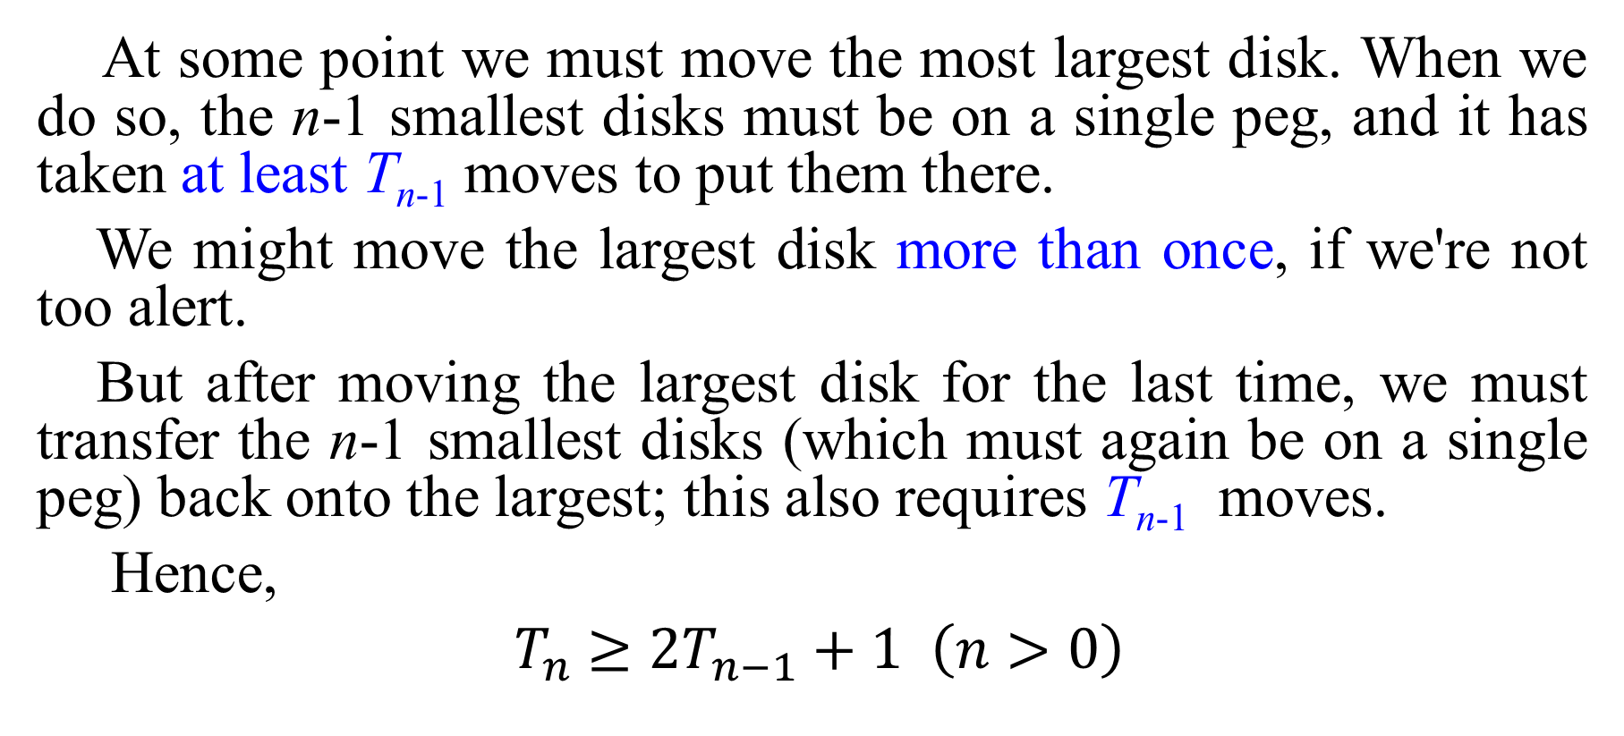
1.1 The Tower of Hanoi
At some point we must move the most largest disk. When we do so, the n-1 smallest disks must be on a single peg, and it has taken at least T_{n-1} moves to put them there.
We might move the largest disk more than once, if we're not too alert.
But after moving the largest disk for the last time, we must transfer the n-1 smallest disks (which must again be on a single peg) back onto the largest; this also requires T_{n-1} moves.
Hence,
$T_{n}$ $≥2T_{n−1}+1 \left(n>0\right)$

Slide 9
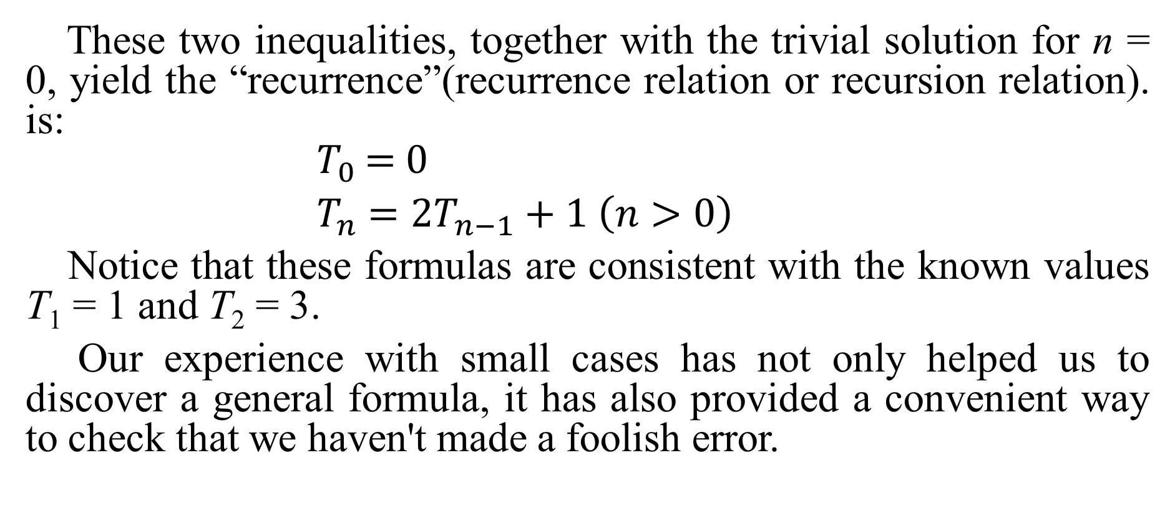
1.1 The Tower of Hanoi
These two inequalities, together with the trivial solution for n = 0, yield the “recurrence”(recurrence relation or recursion relation). is:
$T_{0}$ =$0$
$T_{n}$ $=2T_{n−1}+1 \left(n>0\right)$
Notice that these formulas are consistent with the known values T₁ = 1 and T₂ = 3.
Our experience with small cases has not only helped us to discover a general formula, it has also provided a convenient way to check that we haven't made a foolish error.
(1.1)

Slide 10
1.1 The Tower of Hanoi
The recurrence allows us to compute T_{n} for any n we like. But when n is large; it takes too long. Because the recurrence only gives indirect, local information.
A solution to the recurrence would make us much happier. That is, we'd like a nice, neat, "closed form" for T_{n} that lets us compute it quickly, even for large n. With a closed form, we can understand what T_{n} really is.
How should we do it? One way is GUESS and PROVE. Now we look (again) at small cases:
T₃ = 2* T₂+1 =7
T₄ = 2* T₃+1 =15
T₅ = 2* T₄+1 =31
T₆ = 2* T₅+1 =63

Slide 11
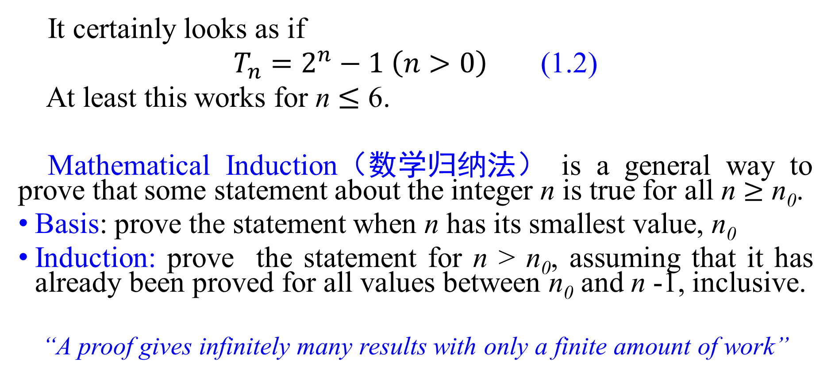
1.1 The Tower of Hanoi
It certainly looks as if
$T_{n}=2^{n}−1 \left(n>0\right)$ (1.2)
At least this works for n $≤$ 6.
Mathematical Induction（数学归纳法） is a general way to prove that some statement about the integer n is true for all n $≥$ n₀.
Basis: prove the statement when n has its smallest value, n₀
Induction: prove the statement for n > n₀, assuming that it has already been proved for all values between n₀ and n -1, inclusive.
“A proof gives infinitely many results with only a finite amount of work”

Slide 12
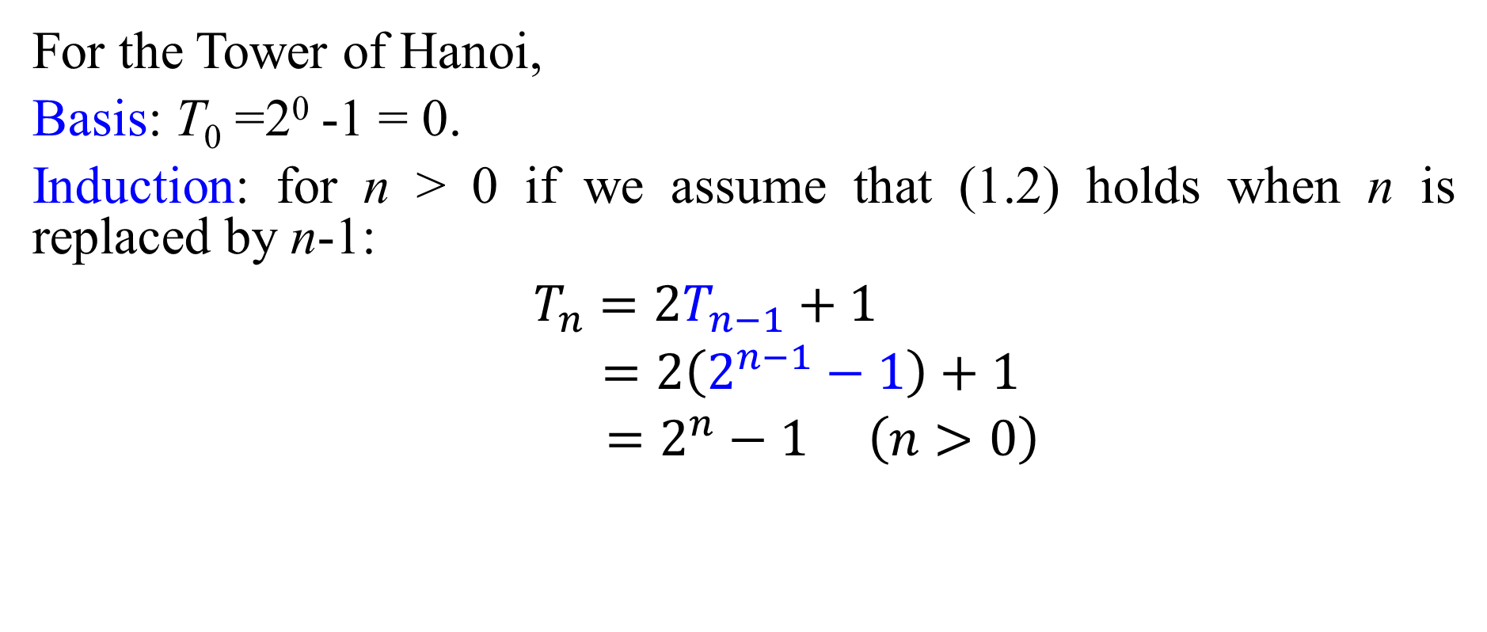
1.1 The Tower of Hanoi
For the Tower of Hanoi,
Basis: T₀ =2⁰ -1 = 0.
Induction: for n > 0 if we assume that (1.2) holds when n is replaced by n-1:
$T_{n}$ $=2T_{n−1}+1$
$=2\left(2^{n−1}−1\right)+1$
$=2^{n}−1 \left(n>0\right)$

Slide 13
1.1 The Tower of Hanoi
The Tower of Hanoi recurrence is typical of many that arise in applications of all kinds. In finding a closed-form expression for some quantity of interest like T_{n} we go through three stages:
(1) Look at small cases. This gives us insight into the problem and helps us in stages 2 and 3.
(2) Find and prove a mathematical expression for the quantity of interest. (recurrence relation)
(3) Find and prove a closed form for our mathematical expression. (recurrence solution)

Slide 14
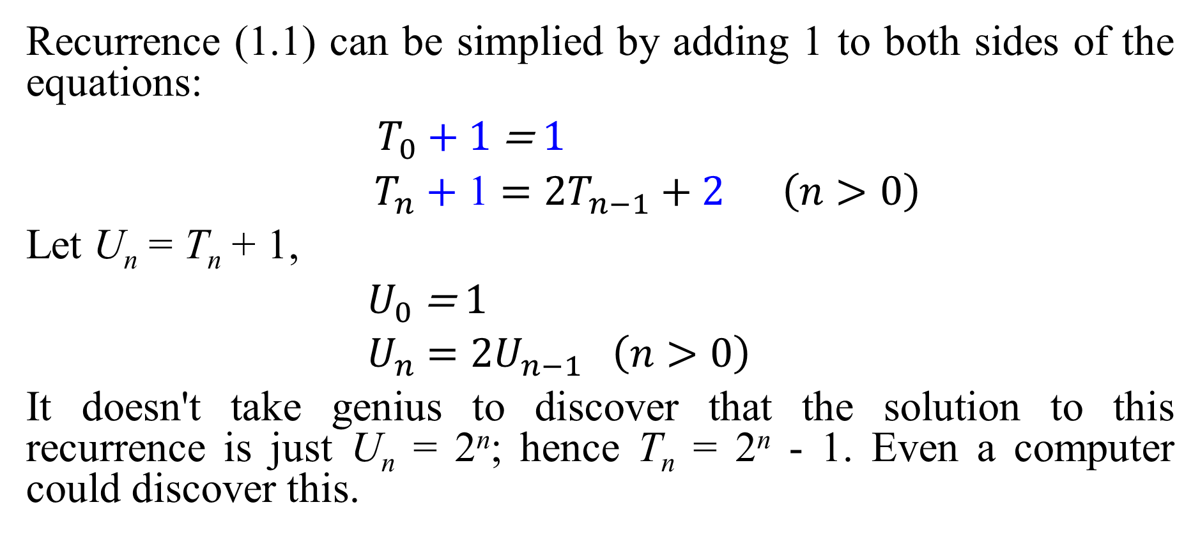
1.1 The Tower of Hanoi
Recurrence (1.1) can be simplied by adding 1 to both sides of the equations:
$T_{0}$ + 1 =$1$
${ T}_{n}$ + 1 $=2T_{n−1}+2 \left(n>0\right)$
Let U_{n} = T_{n} + 1,
$U_{0}$=$1$
$U_{n}$ $=2U_{n−1} \left(n>0\right)$
It doesn't take genius to discover that the solution to this recurrence is just U_{n} = 2^{n}; hence T_{n} = 2^{n} - 1. Even a computer could discover this.
(1.3)

Slide 15
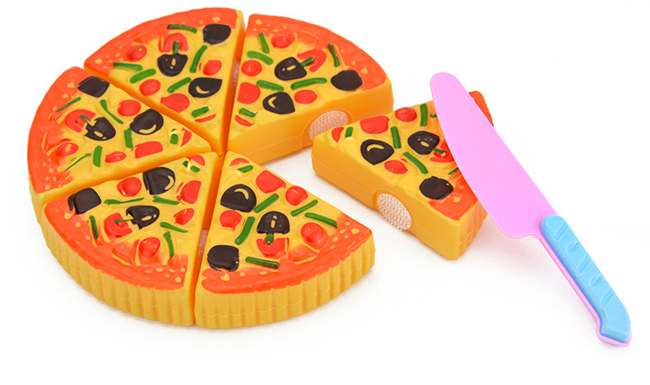
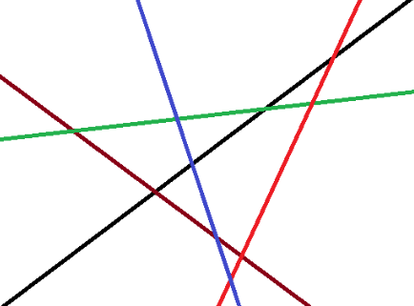
1.2 Lines in the Plane
Q1: How many slices of pizza can a person obtain by making n straight cuts with a pizza knife?
Q2: What is the maximum number L_{n} of regions defined by n lines in the plane?
This problem was first solved in 1826 by the Swiss mathematician Jacob Steiner.

Slide 16

1.2 Lines in the Plane
Again we start by looking at small cases, remembering to begin with the smallest of all.
1
1
1
2
4
2
3
L₀= 1
L₁= 2
L₂= 4
Now L_{n}= ? It seems like that L_{n}= 2^{n}.

Slide 17

1.2 Lines in the Plane
The nth line (for n >0) increases the number of regions by k if and only if it splits k of the old regions.
It splits k old regions if and only if it hits the previous lines in k-1 different places.
The new line can intersect the n-1 old lines in at most n-1 different points.
So k ≤ n.
Unfortunately, L_{n} ≠ 2^{n}.
1b
1a
4
2a
2b
3a
3b
L₃= 7
$$L_{n}≤L_{n−1}+k \left(n>0\right)$$

Slide 18
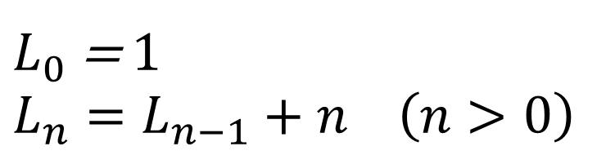
1.2 Lines in the Plane
It's easy to show by induction that the recurrence is:
$L_{0}$ = 1
$$L_{n}=L_{n−1}+n \left(n>0\right)$$
(1.4)
The known values of L₁, L₂, and L₃ check perfectly here.
Now can you show a closed-form solution? Maybe we can’t guess it easily.

Slide 19

1.2 Lines in the Plane
Unfolding / Unwinding
$L_{n}=L_{n−1}+\text{n}$
$=L_{n−2}+\text{(}n$-1) $+$n
$=L_{n−3}+\text{(}n$-2) $+$(n-1) $+$n
$=$ …
$=$ $L_{0}$ $+$1 $+$2 $+$3 $+$ …$+\text{(}n\text{−}\text{2)}$ $+$(n-1) $+$n
$=$ 1 $+$ $S_{n}$
Where $S_{n}$= 1 $+$2 $+$3 $+$ …$+(\text{n}$-2) $+$(n-1) $+$n

Slide 20
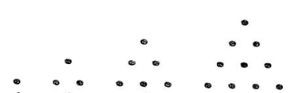
1.2 Lines in the Plane
The quantity S_{n} is worth making a table of small values.
They are called “Triangular Numbers”
n | 1 | 2 | 3 | 4 | 5 | 6 | 7 | 8
S_{n} | 1 | 3 | 6 | 10 | 15 | 21 | 28 | 36

Slide 21
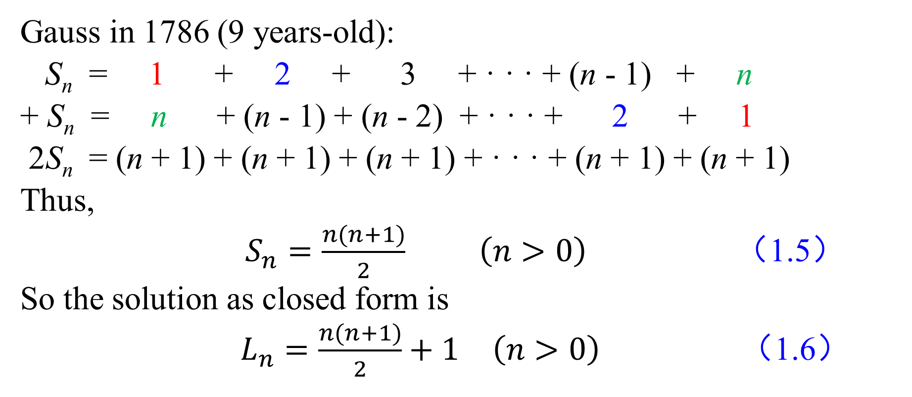
1.2 Lines in the Plane
Gauss in 1786 (9 years-old):
S_{n} = 1 + 2 + 3 + · · · + (n - 1) + n
+ S_{n} = n + (n - 1) + (n - 2) + · · · + 2 + 1
2S_{n} = (n + 1) + (n + 1) + (n + 1) + · · · + (n + 1) + (n + 1)
Thus,
$S_{n}=\frac{n(n+1)}{2}$ $\left(n>0\right)$ （1.5）
So the solution as closed form is
$L_{n}=\frac{n(n+1)}{2}+1$ $\left(n>0\right)$ （1.6）

Slide 22
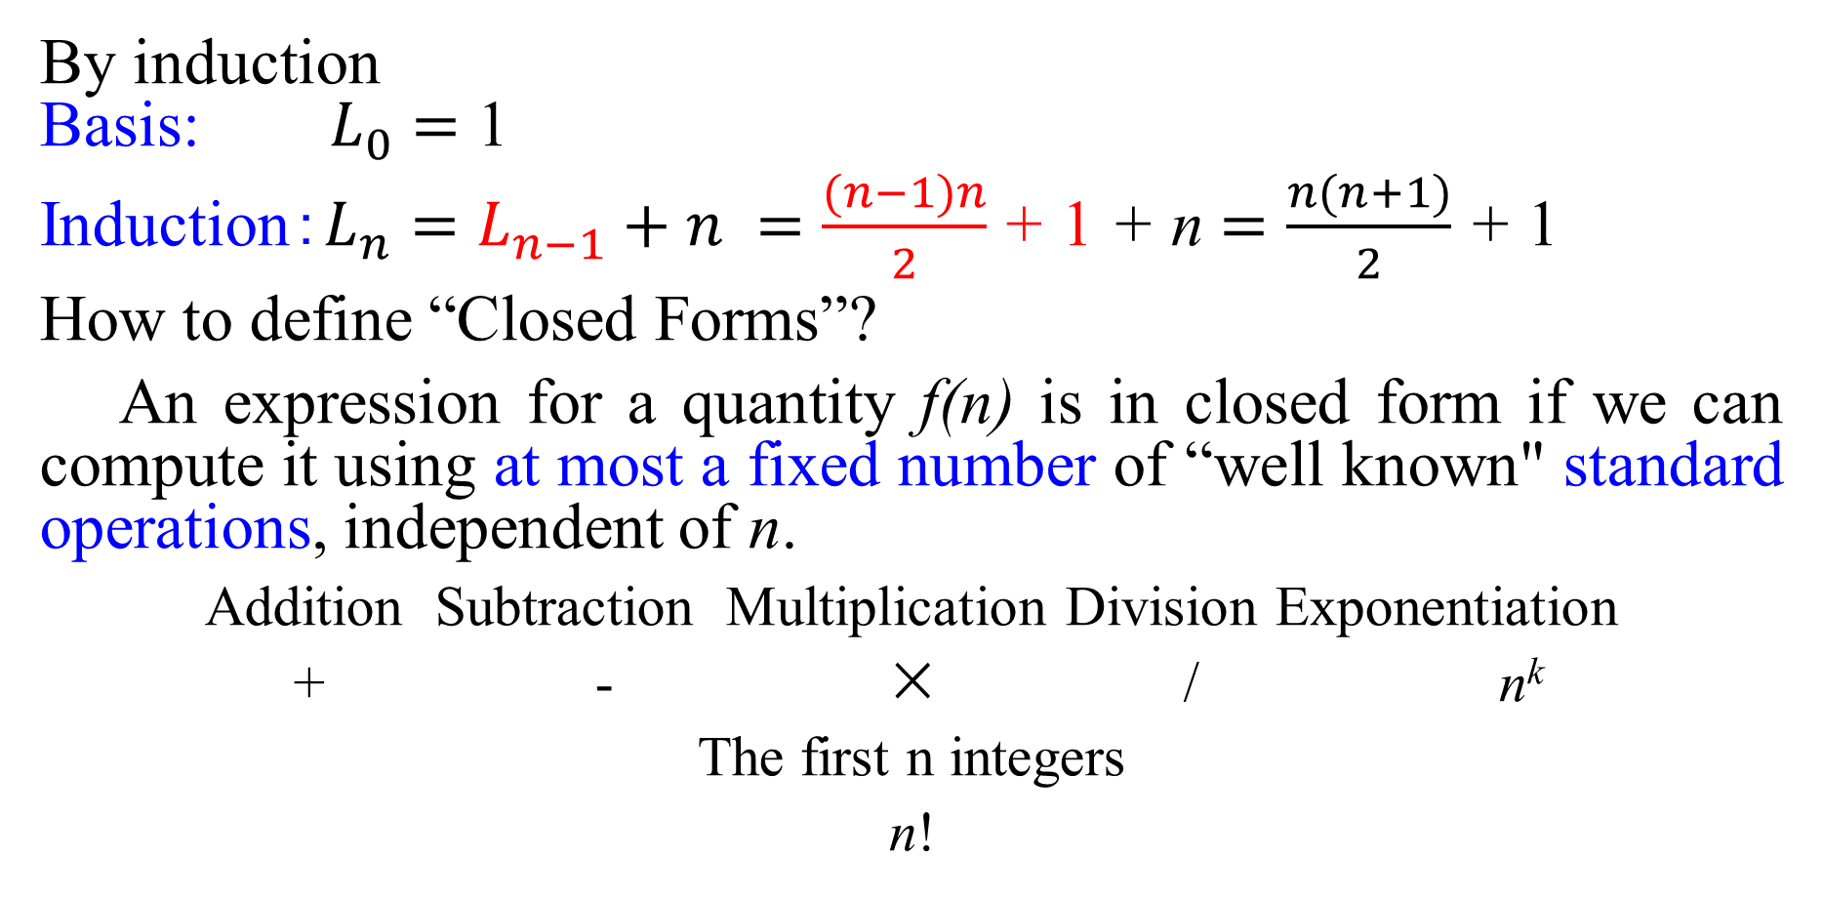
1.2 Lines in the Plane
By induction
Basis: $L_{0}=$ 1
Induction:$L_{n}=L_{n−1}+n =\frac{(n−1)n}{2}$ + 1 + n $=\frac{n(n+1)}{2}$ + 1
How to define “Closed Forms”?
An expression for a quantity f(n) is in closed form if we can compute it using at most a fixed number of “well known" standard operations, independent of n.
Addition Subtraction Multiplication Division Exponentiation
+ - × / n^{k}
The first n integers
n!

Slide 23
1.2 Lines in the Plane
A variation of the lines-in-the-plane problem: BENT line instead of STRAIGHT lines.
1
1
2
1
2
7
3
6
5
4
Z₀= 1
Z₁= 2
Z₂= 7
A bent line is like two straight lines except that regions merge when the “two” lines don't extend past their intersection point.
1
4
2
Z_{n} VS L_{2n} ???
3

Slide 24
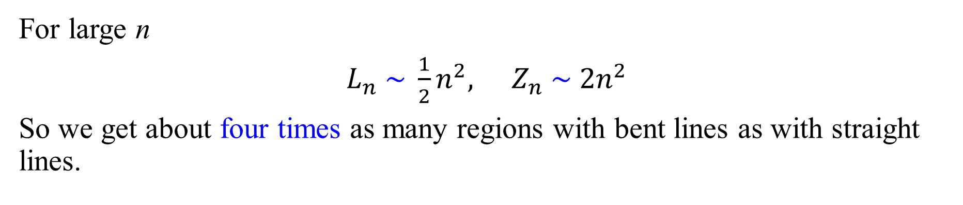
1.2 Lines in the Plane
When there‘s a bent line; we lose two regions.
1
4
2
1, 3, 4 -> “1”
3
$$Z_{n}=L_{2n}−2n= \frac{2n\left(2n+1\right)}{2}+1−2n=2n2−n+1(n≥0) (1.7)$$
For large n
$L_{n} \sim \frac{1}{2}n^{2},$ $Z_{n} \sim 2n^{2}$
So we get about four times as many regions with bent lines as with straight lines.

Slide 25
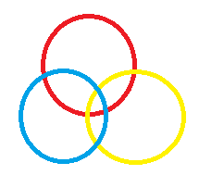
思考：
用圆、三角形、四边形等切割平面，如何求解递推关系？

Slide 26

1.3 The Josephus Problem
It’s an ancient problem named for Flavius Josephus, a famous historian of the first century.
During the Jewish-Roman war, he was among a band of 41(n) Jewish rebels trapped in a cave by the Romans. Preferring suicide to capture, the rebels decided to form a circle and, proceeding around it, to kill every third(m) remaining person until no one was left.
Location of survivor (k)

Slide 27
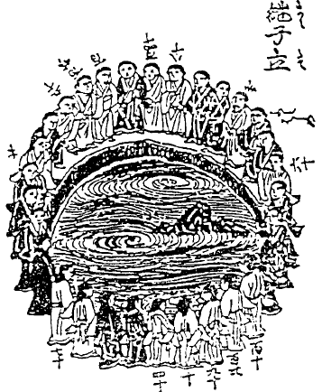
1.3 The Josephus Problem
东方趣闻——日本继子立问题：
谓之继子立者，俗谚曰：往昔，富农有子三十人，内十五人前妻之子，十五人后妻之子也。后妻以为令我所产子嗣夫家。或时，谓夫曰：交立三十子，而定算初，顺算而中十者脱去之，使最末止者，嗣家乎？夫诺。即后妻如前图立之，从算初顺算，而既脱去继子十四人，止一人。彼曰：迄今，一偏脱去了，请此后以我为算初，逆算，而脱去焉。乃如其言，终，后妻子之脱尽，而彼继子一人止，得嗣夫家也。此甚野鄙之语，而虽不足取之，然又于算不可无术也。故扩充之，以述其法也。
——关孝和（约1642-1708）《算脱之法》􀀉
吉田光由（1598-1672）《尘劫记》
对关孝和数学研究产生较大影响的中国数学著作包括《杨辉算法》《天文大成管窥辑要》等。

Slide 28
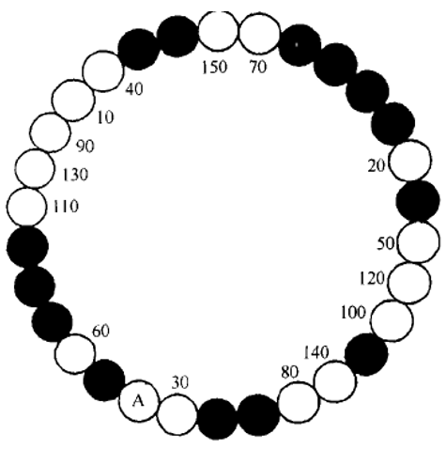
1.3 The Josephus Problem
东方趣闻——日本继子立问题：
* 思考：能否通过程序设计恢复出一种最初30个儿子的站位？
由15个个白球、15个黑球构成的圆形队列，
前14次：从给定位置开始，顺时针数逢十去一，去掉的皆为白球，
后15次：从当前位置继续，逆时针数逢十去一，去掉的皆为黑球，
最后剩余的为白球。
B
60
20
70
120
140
30
100
130
150
40
10
90
110
50
80
黑球
A为继室预设起点顺时针开始，
至150被叫停，从该位置逆时针继续
n₁=30, n₂=16, m=10

Slide 29
1.3 The Josephus Problem
东方趣闻——中国古代趣题：
环二十子，内有二黑子相连。以九数之，止处即除一子，除毕，二黑不动。宜从何处起？
通曰：五为九之中。左右各四，离黑子四位起可也。
——方中通（1633-1698）《数度衍》􀀉
起点
1
17
18
19
20
2
3
4
5
6
7
8
9
10
11
12
13
14
15
16
n=20, m=9

Slide 30
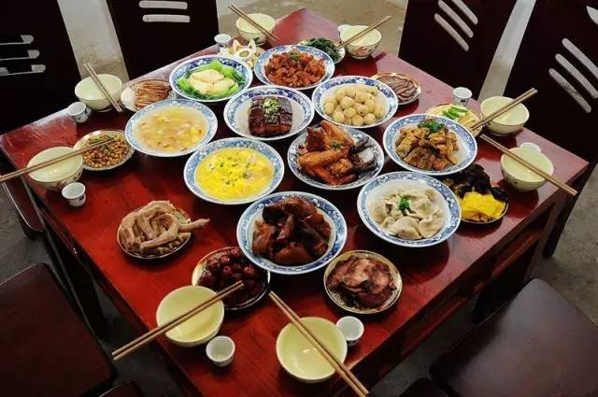
1.3 The Josephus Problem
东方趣闻——八仙赴宴：
八仙同赴王母宴。宴会主持官员为不使吕洞宾坐首席，出主意让八仙排成圆圈，并暗示小吏，从吕洞宾前一人起，按此前后次序查数。数多少以随机掷两颗散子为准。数到谁，谁就退出圈外。继续点数，直至最后一人，他坐首席。这种方法表面上看不出主持官员做的手脚。其实，不论般子掷出多少点，吕洞宾总是坐不上首席。
（设局精巧，n=8, m随机选取，且2≤m≤12）􀀉
八仙桌

Slide 31
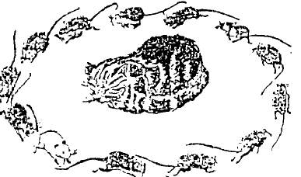
1.3 The Josephus Problem
东方趣闻——猫鼠游戏：
十三鼠为猫所捕，欲逃而不能。乃互私议，得一法。谓猫曰：今日汝欲杀余等，余等无力以抗，抵得俯首待笼。但余等有一特别游戏，愿与君共行之，则余等虽死，无憾矣。即君之食余等也，亦愈觉更有味矣！不知君以为然否？
猫曰：善！请道其详。
鼠曰：余等排列为一圈，任君从何处为起点，绕圈而走，至第十三个则取而食之。然后再从被食者之次数起，数至第十三个，再取而食之。如是至最后，则余等皆为君食尽。但余辈中有一白色者，其肉嫩而肥，可供君作最后之佳肴。君须稍加思索：若从何处数起，则白者可留至最后食。
猫曰：稍待，余缓思之。不意猫思索良久，觉困倦异常，遂酣然入黑甜乡矣。群鼠见猫熟睡，知已中计，一哄而散，安然各入洞中矣。(n=13, m =13)
——陈怀书《数学游戏大观》，商务印书馆，1923. （我国第一本游戏专著）

Slide 32
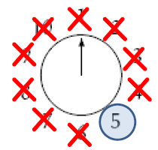
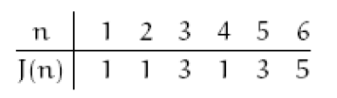
1.3 The Josephus Problem
A small case:
Start with n people numbered 1 to n around a circle, and eliminate every second remaining person until only one survives.
For n = 10, the elimination order is 2, 4, 6, 8, 10, 3, 7, 1, 9, so 5 survives.
Q: How determine the survivor's number J(n)?
Maybe you guess: J(n) = n/2 when n is even,
But it is incorrect.
J(n) seems to be odd.

Slide 33
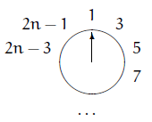
1.3 The Josephus Problem
(1) Suppose that we have 2n people originally. After the first ground:
3 will be the next to go.
This is just like starting out with n people, except that each person's number has been doubled and decreased by 1.
J(2n) = 2J(n)–1 (n≥1)
J(10) = 5, so J(20) = 2J(10) - 1 = 2×5 - 1 = 9 and J(40) = 2J(20) – 1=17.
Deduce:
J(5·2^{m}) = 2^{m+1} + 1.n

Slide 34
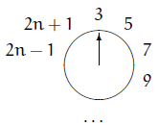
1.3 The Josephus Problem
(2) Suppose that we have 2n+1 people. It turns out that person number 1 is wiped out just after person number 2n:
Again we almost have the original situation with n people, but this time their numbers are doubled and increased by 1.
J(2n+1) = 2J(n)+1 (n≥1)

Slide 35
1.3 The Josephus Problem
Combining these equations with J(1) = 1 gives us a recurrence that defines J all cases:
J(1) = 1
J(2n) = 2J(n) - 1 (n≥1)
J(2n + 1) = 2J(n) + 1 (n≥1)
Instead of getting J(n) from J(n-1), this recurrence is much more efficient because it reduces n by a factor of 2 or more each time it's applied.
A closed form is needed because that will be even quicker and more informative.
“To be or not to be ,this is a question.”
(1.8)

Slide 36

单选题
1分
答案解析
1. 根据公式(1.8)计算J(1000000) 至少（ ）次。
2¹⁹＜1000000 ＜ 2²⁰
A
17
B
18
C
19
D
20
提交
可为此题添加文本、图片、公式等解析，且需将内容全部放在本区域内。正常使用需3.0以上版本

Slide 37

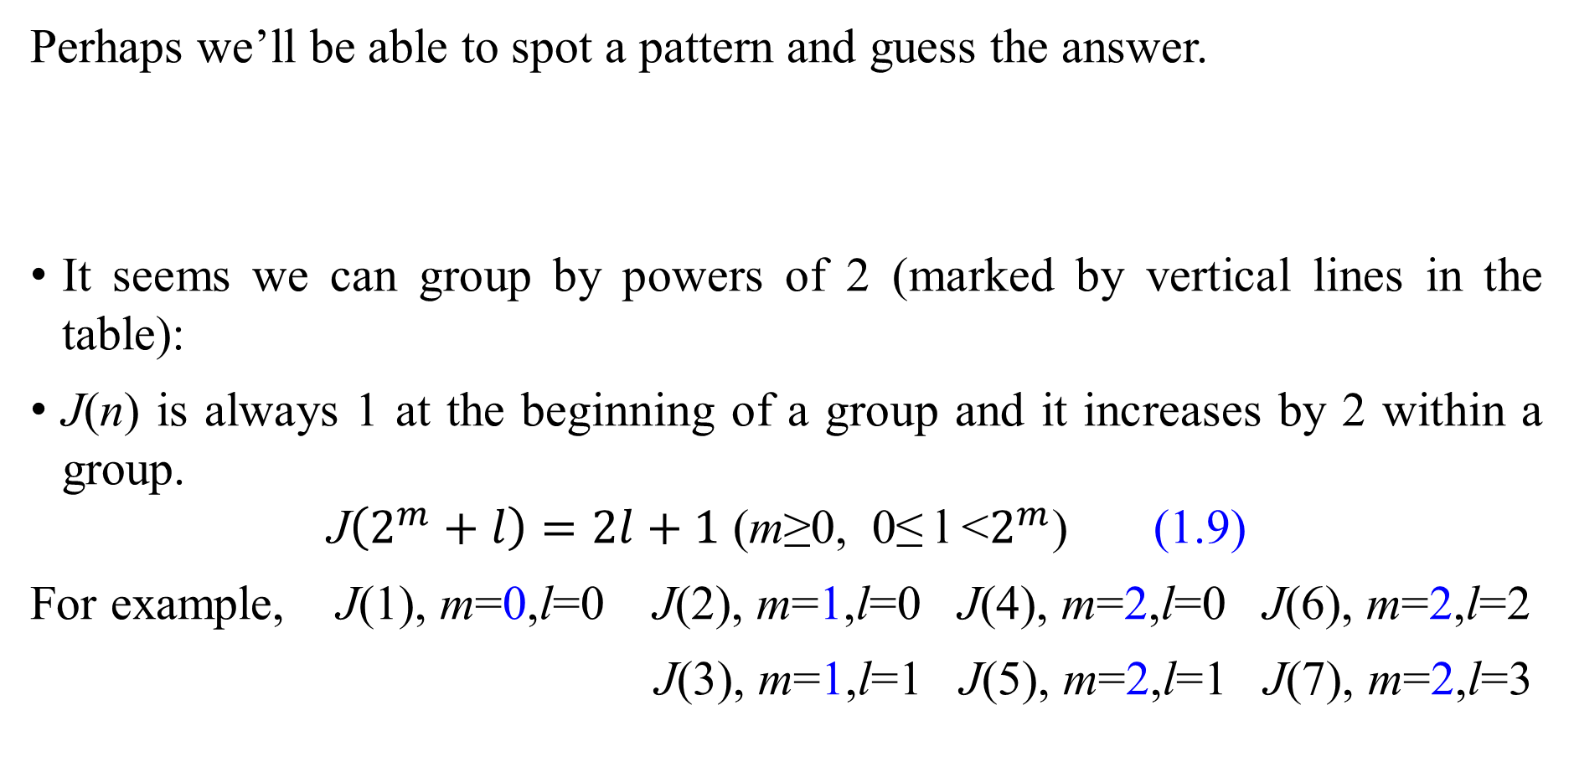
1.3 The Josephus Problem
Perhaps we’ll be able to spot a pattern and guess the answer.
It seems we can group by powers of 2 (marked by vertical lines in the table):
J(n) is always 1 at the beginning of a group and it increases by 2 within a group.
$\text{J}\left(2^{m}+l\right)=2l+1$ (m≥0, 0≤ l <$2^{m}$) (1.9)
For example, J(1), m=0,l=0 J(2), m=1,l=0 J(4), m=2,l=0 J(6), m=2,l=2
J(3), m=1,l=1 J(5), m=2,l=1 J(7), m=2,l=3

Slide 38
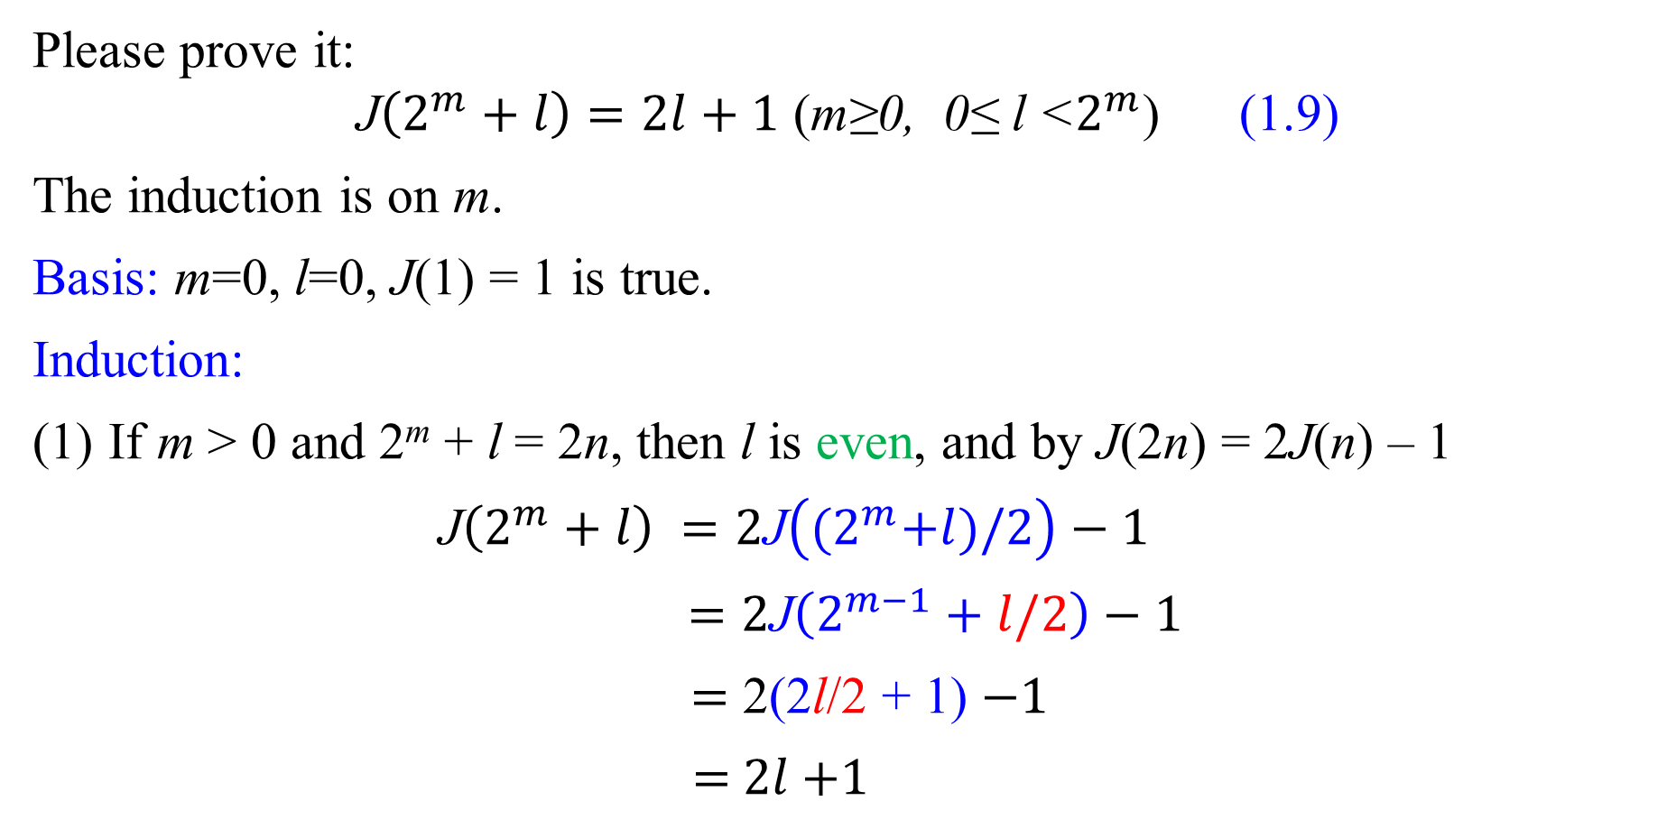
1.3 The Josephus Problem
Please prove it:
$\text{J}\left(2^{m}+l\right)=2l+1$ (m≥0, 0≤ l <$2^{m}$) (1.9)
The induction is on m.
Basis: m=0, l=0, J(1) = 1 is true.
Induction:
If m > 0 and 2^{m} + l = 2n, then l is even, and by J(2n) = 2J(n) – 1
$\text{J}\left(2^{m}+l\right) =2\text{J}\left({(2}^{m}+l)/2\right)−1$
$=2\text{J}\left(2^{m−1}+l/2\right)−1$
$=$ 2(2l/2 + 1) $−1$
$=$ 2$l$+1

Slide 39
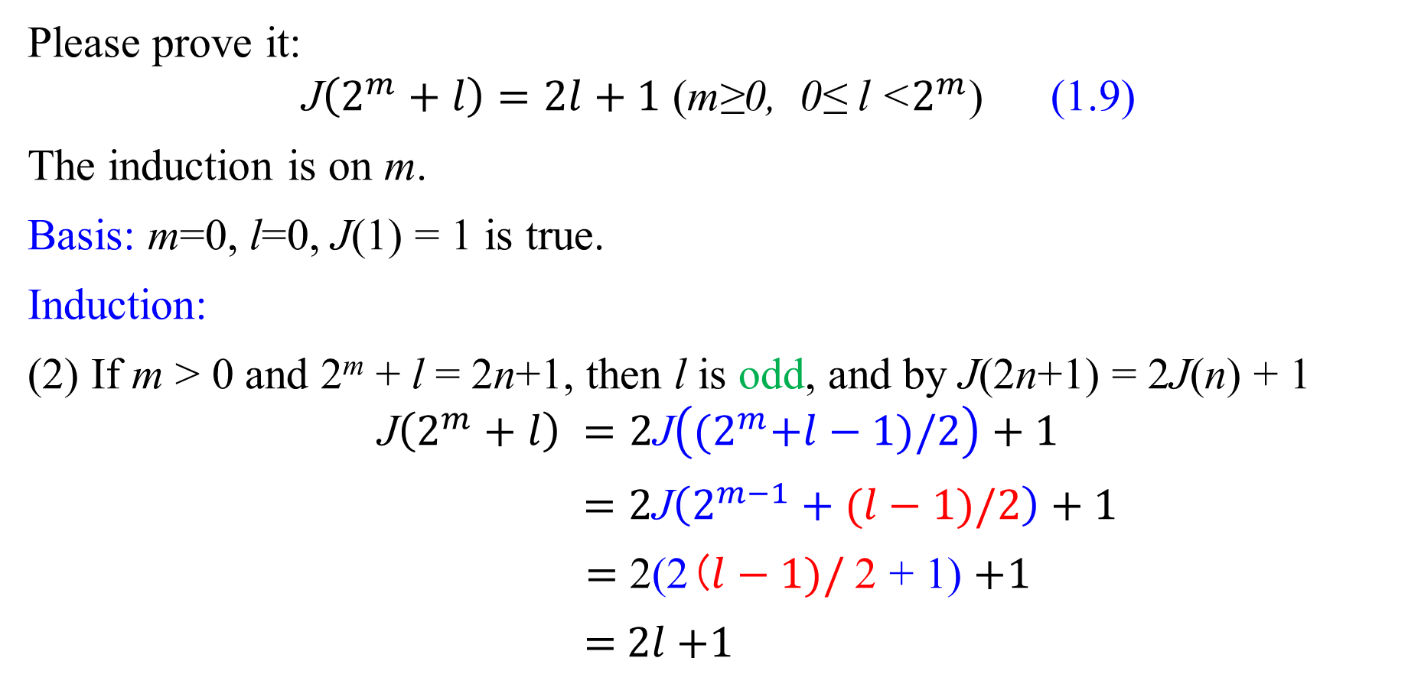
1.3 The Josephus Problem
Please prove it:
$\text{J}\left(2^{m}+l\right)=2l+1$ (m≥0, 0≤ l <$2^{m}$) (1.9)
The induction is on m.
Basis: m=0, l=0, J(1) = 1 is true.
Induction:
(2) If m > 0 and 2^{m} + l = 2n+1, then l is odd, and by J(2n+1) = 2J(n) + 1
$$\text{J}\left(2^{m}+l\right) =2\text{J}\left({(2}^{m}+l−1)/2\right)+1$$
$=2\text{J}\left(2^{m−1}+(l−1)/2\right)+1$
$=$ 2(2($l−1)/$2 + 1) $+1$
$=$ 2$l$+1

Slide 40
1.3 The Josephus Problem
Besides,
J(1) = 1
J(2n) = 2J(n) - 1 (n≥1)
J(2n + 1) = 2J(n) + 1 (n≥1)
J(2n + 1) - J(2n) = 2
For example,
J(100) = J(2⁶+36) = 2×36+1 = 73
Every solution to a problem can be generalized so that it applies to a wider class of problems. Now we will uncover the structure that underlies all such problems.

Slide 41
单选题
1分
答案解析
2. 根据递推式， 求J(1000)=( )。
J(1) = 1
J(2n) = 2J(n) - 1 (n≥1)
J(2n + 1) = 2J(n) + 1 (n≥1)
J(1000)=2⁹+488
因此m=9，l=488
2l+1=977
A
500
B
976
C
977
D
1000
提交
可为此题添加文本、图片、公式等解析，且需将内容全部放在本区域内。正常使用需3.0以上版本

Slide 42
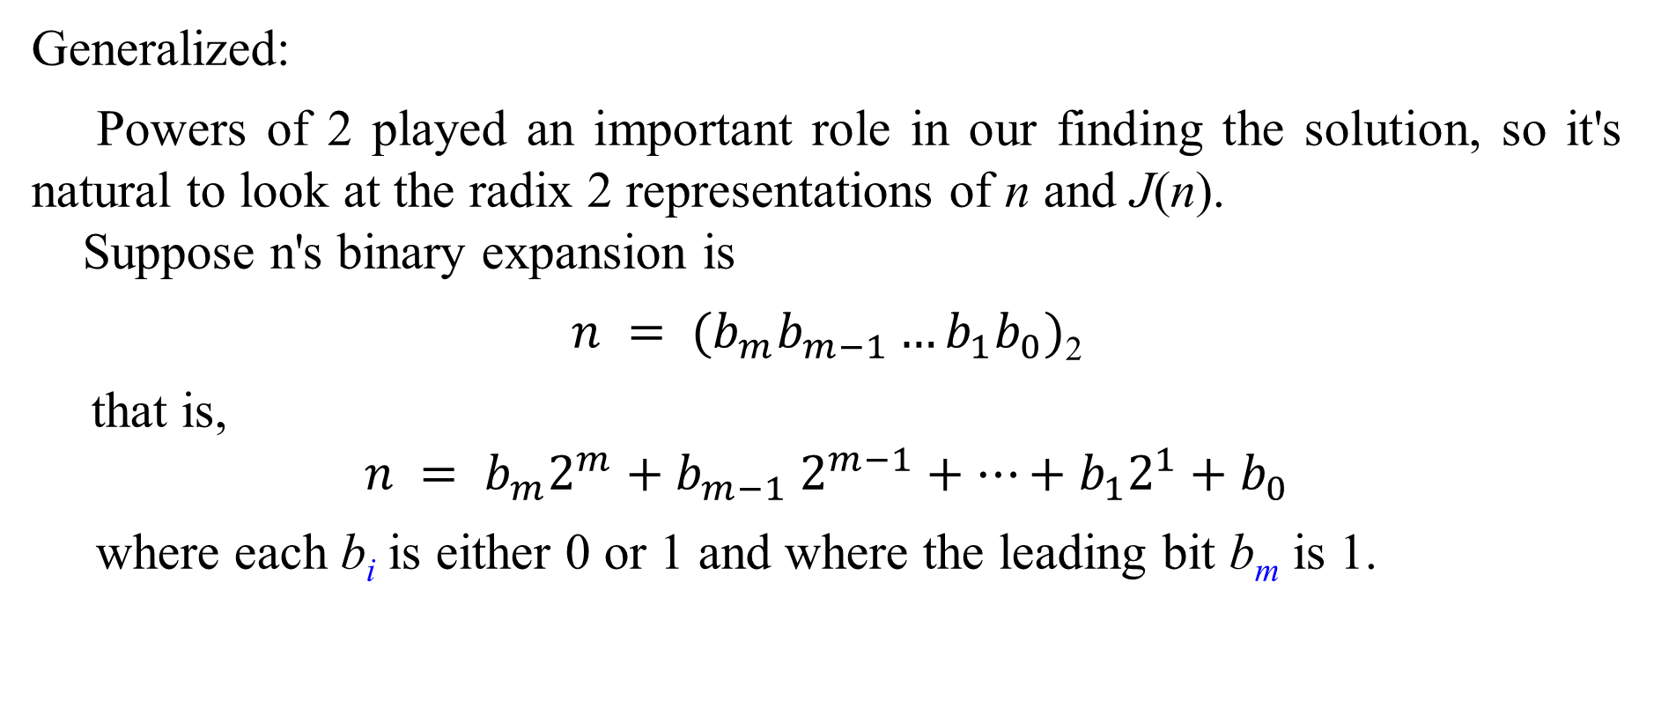
1.3 The Josephus Problem
Generalized:
Powers of 2 played an important role in our finding the solution, so it's natural to look at the radix 2 representations of n and J(n).
Suppose n's binary expansion is
$n = (b_{m}b_{m−1}…b_{1}b_{0})$₂
that is,
$$n = b_{m}2^{m}{+ b}_{m−1}2^{m−1}+…+b_{1}2^{1}+b_{0}$$
where each b_{i} is either 0 or 1 and where the leading bit b_{m} is 1.

Slide 43
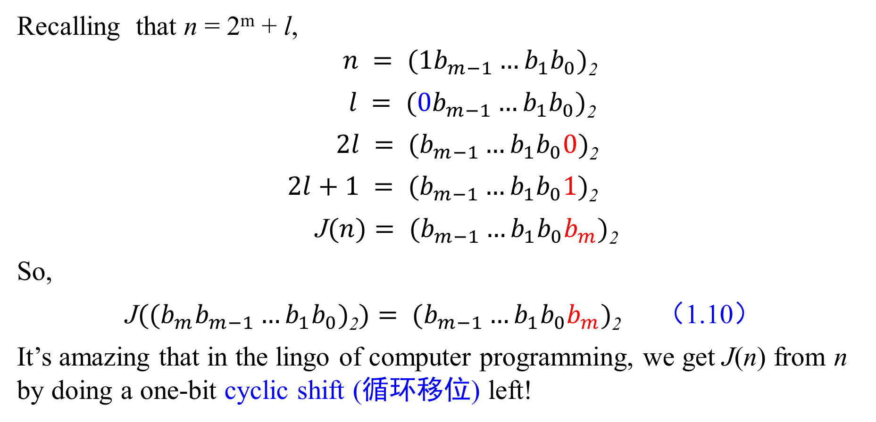
1.3 The Josephus Problem
Recalling that n = 2^{m} + l,
$n = (1b_{m−1}…b_{1}b_{0})$₂
$l = (0b_{m−1}…b_{1}b_{0})$₂
$2l = (b_{m−1}…b_{1}b_{0}0)$₂
$2l+1 = (b_{m−1}…b_{1}b_{0}1)$₂
J$(n)= (b_{m−1}…b_{1}b_{0}b_{m})$₂
So,
$\text{J}((b_{m}b_{m−1}…b_{1}b_{0})\text{2})= (b_{m−1}…b_{1}b_{0}b_{m})$₂ （1.10）
It’s amazing that in the lingo of computer programming, we get J(n) from n by doing a one-bit cyclic shift (循环移位) left!

Slide 44
1.3 The Josephus Problem
For example,
J(100) = J(1100100)₂ = (1001001)₂ = 73
Can you show J(10000) by this way?
If we start with n and iterate the J function m+1 times, we‘re doing m+1 one-bit cyclic shifts. Since n is an (m+1)-bit number, we might expect to end up with n again. But this doesn’t quite work.
For example,
if n = 13, we have J(1101)₂ = (1011)₂,
but then J(1011) ₂ = (0111) ₂ and the process breaks down. The 0 disappears when it becomes the leading bit.

Slide 45
1.3 The Josephus Problem
J(n) must always be ≤ n by definition, since J(n) is the survivor's number; hence if J(n) < n we can never get back up to n by continuing to iterate.
Repeated application of J produces a sequence of decreasing values that eventually reach a “fixed point”, where J(n) = n:
J(0111) ₂ = J (111) ₂= (111) ₂
Iterating the function enough times will always produce a pattern of all 1's whose value is 2^{v(n)}-1. (v(n) is the number of 1 bits in the binary representation of n.)
J(J(… J(13) …)) = 2³ - 1 = 7
J(J…J((101101101101011)₂) …)) = 2¹⁰ - 1 = 1023

Slide 46
1.3 The Josephus Problem
Let’s return briefly to our first guess, that J(n) = n/2 when n is even.
This is obviously not true in general, but we can now determine exactly when it is true:
if n = 2^{m} + l, J(n) = n/2
then 2l + 1 = (2^{m} + l)/2
so l = (2^{m} - 2)/3
If this number l = (2^{m} - 2) /3 is an integer, n = 2^{m}+l will be a solution, because l < 2^{m}. We can prove:
(1) when m is odd, 2^{m} - 2 is a multiple of 3;
(2) when m is even, 2^{m} - 2 is NOT a multiple of 3.

Slide 47
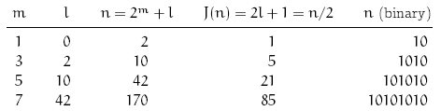
1.3 The Josephus Problem
There are infinitely many solutions to the equation J(n) = n/2 when n is even.
We understand the J function pretty well; the next step is to generalize it.

Slide 48
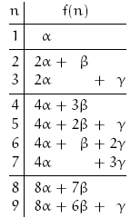
1.3 The Josephus Problem
Let’s investigate this by introducing constants α, β,γ and trying to find a closed form for the more general recurrence (1.11):
J(1) = 1
J(2n) = 2J(n) – 1 (n≥1) (1.8)
J(2n + 1) = 2J(n) + 1 (n≥1)
f(1) = α
f(2n) = 2f(n) + β (1.11)
f(2n + 1) = 2f(n) + γ
(Our original recurrence had α = 1, β = -1, and γ = 1.)
We can construct the general table for small values of n.

Slide 49
1.3 The Josephus Problem
It seems that α's coefficient is n's largest power of 2.
Between powers of 2, β's coefficient decreases by 1 down to 0 and γ's increases by 1 up from 0.
Therefore if we express f(n) in the form
f(n) = A(n) α + B(n) β + C(n) γ (1.13)
by separating out its dependence on α, β, γ, it seems that A(n) = 2^{m}
B(n) = 2^{m} – l – 1 (1.14)
C(n) = l
as usual, n= 2^{m} + l and 0≤ l <2^{m} for n≥1.
(1.12)

Slide 50
1.3 The Josephus Problem
f(n) = A(n) α + B(n) β + C(n) γ (1.13)
A(n) = 2^{m}
B(n) = 2^{m} – l – 1 (1.14)
C(n) = l
It's not terribly hard to prove (1.13) and (1.14) by induction, but the calculations are messy and uninformative.
There's a better way to proceed, by choosing particular values and then combining them. Let's illustrate this by considering the special case α = 1, β = γ = 0, when f(n) is supposed to be equal to A(n):
A(1) = 1
A(2n) = 2A(n) (n≥1)
A(2n+1) = 2A(n) (n≥1)
It’s true (by induction on m) that A(2^{m} + l) = 2^{m}

Slide 51
1.3 The Josephus Problem
Next, let’s use recurrence (1.11) and solution (1.13) in reverse, by starting with a simple function f(n) and seeing if there are any constants (α, β, γ) that will define it.
f(1) = α
f(2n) = 2f(n) + β (1.11)
f(2n + 1) = 2f(n) + γ
f(n) = A(n) α + B(n) β + C(n) γ (1.13)
Plugging the constant function f(n)=1 into (1.11):
1 = α，1 = 2·1+ β，1 = 2·1+ γ hence (α, β, γ) = (1, –1, –1)
Similarly, we can plug in f(n) = n:
1 = α，2n = 2n + β，2n + 1 = 2n + γ hence (α, β, γ) = (1, 0, 1)
So we don't need to prove by induction that these parameters will yield f(n) = n.

Slide 52
1.3 The Josephus Problem
Now we're essentially done! We have shown that the functions A(n), B(n), and C(n) of (1.13), which solve (1.11) in general, satisfy the equations
(α, β, γ) = (1, 0, 0) → A(n) = 2^{m} 【f(n) = 2^{m}】(n = 2^{m} + l and 0 ≤ l < 2^{m} )
(α, β, γ) = (1, -1, -1) → A(n) – B(n) – C(n) = 1【f(n) = 1】
(α, β, γ) = (1, 0, 1) → A(n) + C(n) = n 【f(n) = n】
Our conjectures in (1.14) follow immediately, since we can solve these equations to get C(n) = n - A(n) = l and B(n) = A(n) - 1 - C(n) = 2^{m} - 1 - l.
A(n) = 2^{m}
B(n) = 2^{m} – l – 1 (1.14)
C(n) = l

Slide 53
1.3 The Josephus Problem
This approach illustrates a surprisingly useful repertoire method for solving recurrences.
First we find settings of general parameters for which we know the solution; this gives us a repertoire of special cases that we can solve.
Then we obtain the general case by combining the special cases. We need as many independent special solutions as there are independent parameters (in this case three, for α, β, and γ).
清单法：
首先观察有限个项的形式，并猜测封闭解，将其写成系数函数与常量的组合形式；
在若干简单的常量组合上，直接求解封闭形式解（注意所选取的常量组合要使得计算尽量简单）
由1、2得到关于系数函数的方程组，解出系数函数，并与常量组合得到最终结果。

Slide 54
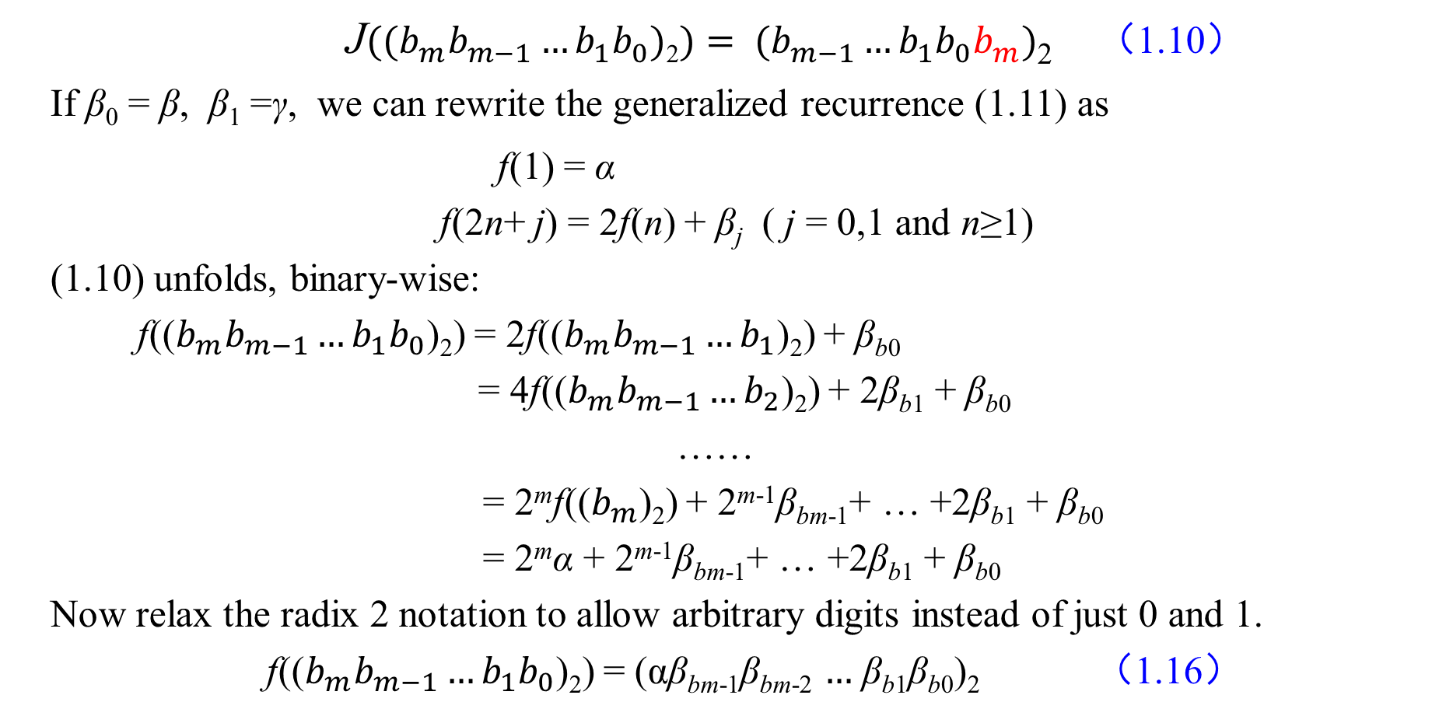
1.3 The Josephus Problem
$\text{J}((b_{m}b_{m−1}…b_{1}b_{0})\text{2})= (b_{m−1}…b_{1}b_{0}b_{m})$₂ （1.10）
If β₀ = β, β₁ =γ, we can rewrite the generalized recurrence (1.11) as
f(1) = α
f(2n+ j) = 2f(n) + β_{j} ( j = 0,1 and n≥1)
(1.10) unfolds, binary-wise:
f(($b_{m}b_{m−1}…b_{1}b_{0}$)₂) = 2f(($b_{m}b_{m−1}…b_{1}$)₂) + β_{b0}
= 4f(($b_{m}b_{m−1}…b_{2}$)₂) + 2β_{b1} + β_{b0}
……
= 2^{m}f(($b_{m}$)₂) + 2^{m-1}β_{bm-1}+ … +2β_{b1} + β_{b0}
= 2^{m}α + 2^{m-1}β_{bm-1}+ … +2β_{b1} + β_{b0}
Now relax the radix 2 notation to allow arbitrary digits instead of just 0 and 1.
f(($b_{m}b_{m−1}…b_{1}b_{0}$)₂) = (αβ_{bm-1}β_{bm-2} $…$ β_{b1}β_{b0})₂ （1.16）
（1.15）

Slide 55
1.3 The Josephus Problem
We would have seen this pattern earlier if we had written (1.12) in another way.
For example, when n = 100 = (1100100)₂, our original
Josephus values α = 1, β = -1, γ= 1.
The cyclic-shift property follows because each block of binary
digits (10… 00)₂ in the representation of n is transformed into
(1 -1 …… -1 -1)₂ = (00……01)₂
So our change of notation has given us the compact solution
(1.16) to the general recurrence (1.15).

Slide 56
1.3 The Josephus Problem
If we’re really uninhibited we can now generalize even more. Start with numbers in radix d and produce values in radix c:
f(j) = α_{j} (1 ≤ j < d)
f(dn + j) = cf(n) + β_{j} （0 ≤ j < d and n ≥ 0）
It has the radix-changing solution :
f((b_{m}b_{m-1}…b₁b₀)_{d}) = (α_{bm}β_{bm-1}β_{bm-2} …… β_{b1}β_{b0})_{c} （1.18）
For example, suppose that by some stroke of luck we're given the recurrence
f(1) = 34 f(2) = 5
f(3n) = 10f(n) + 76 ( n ≥ 1）
f(3n + 1) = 10f(n) – 2 ( n ≥ 1）
f(3n + 2) = 10f(n) + 8 ( n ≥ 1）
（1.17）

Slide 57
1.3 The Josephus Problem
f(1) = 34
f(2) = 5
f(3n) = 10f(n) + 76 ( n ≥ 1）
f(3n + 1) = 10f(n) – 2 ( n ≥ 1）
f(3n + 2) = 10f(n) + 8 ( n ≥ 1）
Suppose we want to compute f(19). Here we have d = 3 and c = 10.
Now 19 = (201)₃, and the radix-changing solution tells us to perform a digit-by-digit replacement from radix 3 to radix 10. So the leading 2 becomes a 5, and the 0 and 1 become 76 and -2, giving
f(19) = f((201)₃) = (5. 76. -2)₁₀ = 5·100+76·10-2·1=1258
Thus Josephus and the Jewish-Roman war have led us to some interesting general recurrences.

Slide 58
单选题
1分
答案解析
3. 已知 f(1) = 3 f(2) = 6 f(3) = 9
f(4n) = 8f(n) + 1 f(4n + 1) = 8f(n) – 1
f(4n + 2) = 8f(n) + 2 f(4n + 3) = 8f(n) – 2 ( n ≥ 1）
求 f(27)结果对应的十进制数是（ ）。
27= (123)₄
f(27) = f((123)₄) = (3. 2. -2)₈ = 3·8²+2·8²-2·8⁰=206
A
123
B
206
C
210
D
369
提交
可为此题添加文本、图片、公式等解析，且需将内容全部放在本区域内。正常使用需3.0以上版本

Slide 59
本章作业
1、一层台阶总共有n级，如果一次可以跳1级，也可以跳2级，求总共有多少种不同跳法？请写出递推式（不需要求解）。
2、n个圆最多可以将平面划分为多少个区域？请给出递推式，并用数学归纳法给出递推式的解。
（提示：每增加一个圆，判断新增区域数量与交点数量有关）
*3、对于约瑟夫环的一般形式，n个人围成一圈，每m个人去掉一人（间隔为m-1），最终剩余1人，尝试找出其递推式f(n,m)。
（提示：f(n,m) 和 f(n-1,m)的关系）

